Slide 1
Newton’s Third Law

Slide 2
By the end of the lesson, you should be able to:
Recall Newton's Third Law.
Explain the consequences of Newton's Third Law.
Explain how seat belts use action-reaction pairs to keep passengers safe.

Slide 3
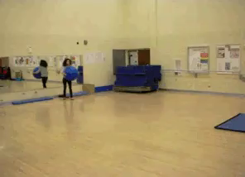
Newton's Third Law states:
For every action force, there is an equal and opposite reaction force.
Let's break this down and see what it means!

Slide 4
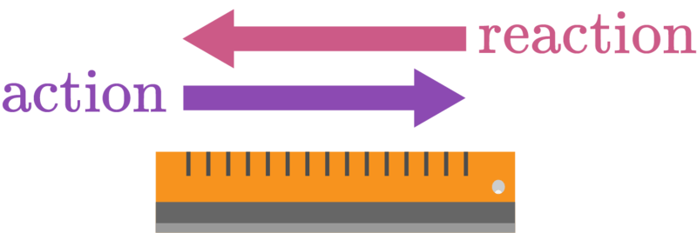
Newton's Third Law means that forces come in pairs.
When one object exerts a force on another object, the second object must exert another force back on the first one.
The force that the first object exerts is the action force. The force that is exerted in response to the action force is the reaction force.

Slide 5
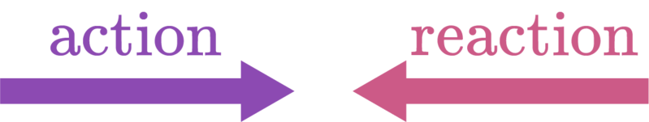
The reaction force is the same size as the action force.
However, the reaction force points in the opposite direction to the action force.

Slide 6
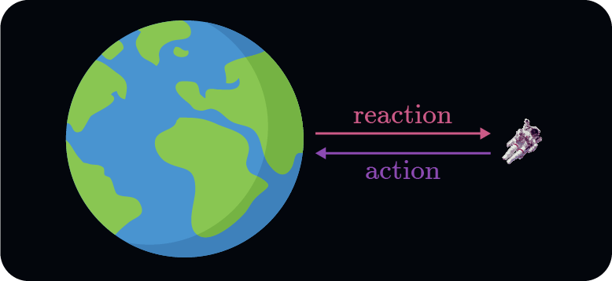
In this case, gravity is an action force that the Earth applies to you.
By Newton's Third Law, this means that you must exert a reaction force on the Earth!
This force points towards you and is the same magnitude as the gravitational force pointing towards the Earth, so the two forces obey Newton's Third Law.

Slide 7
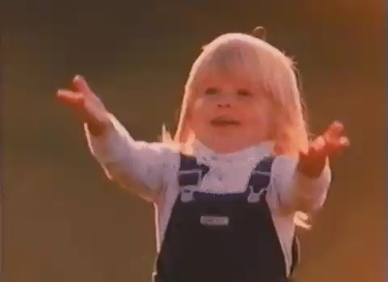
Let's look at a few more examples of action-reaction pairs.
One example that you're probably already familiar with occurs when you catch a ball while playing sports.
If the ball is moving very quickly when you catch it, your hands need to apply a large action force to the ball to make it stop. By Newton's Third Law, the ball will apply a large reaction force to your hands.

Slide 8
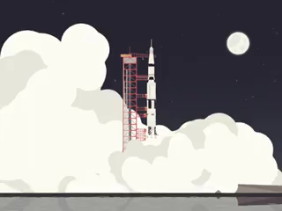
Rockets use Newton's Third Law to move.
Rockets burn their fuel extremely quickly, producing hot gases. The rocket applies an action force to the gases, forcing them out the back of the rocket. This means that the gases must apply a reaction force to the rocket, pushing it forward.
This allows the rocket to move in the vacuum of space!

Slide 9
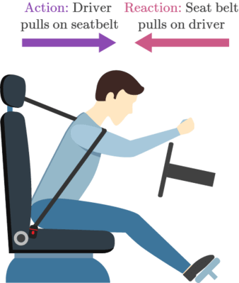
Seat belts also use action-reaction pairs.
If you are in a car crash that caused your car to stop suddenly, you would continue to move forward due to your inertia (Newton's First Law).
If you're wearing your seat belt, you will apply an action force to it, equal to the force throwing you forward.
Your seat belt will then apply a reaction force back to you. This stops you from moving forward, preventing you from going through the windshield.

